Slide 1

NBA Finals Playoff Bracket
Brian Brungardt
Liam Crawley
Nathan Fraser
Jack Hill
Christopher Hyland
Taylor Neal
Andy Wang

Slide 2
Purpose
A model is being created to generate a predicted winner along with a complete bracket prediction for the 2022 NBA Finals.
A Monte Carlo simulation is also performed with an iteration of 1000 times to predict how many games out of 1000 times a team will win the tournament.

Slide 3
Road Map
Data Collection
Data Cleaning
Model Fitting
Visualization
Simulation
Winner Prediction

Slide 4
Methods
We are using public data from sportsreference.com by aggregating the data into a database using SQL and GCP.
A probit model is then constructed and trained on the newly created database, forming winning probabilities for each matchup of teams.
A probit model is used because score differentials tend to follow a normal distribution pattern, giving us the best chance of having accurate predictions.

Slide 5
Data Collection and Wrangling
We collected team vs team, shooting stats and offensive/defensive rates from sportref.com
We utilized SQL to join multiple table together and reformatted it so it was suitable for regression

Slide 6
Regression fitting
We used Lasso in R to estimate covariance over the regular season stats under supervision. We utilized machine learning via sklearn
The Lasso method allowed us to penalized the addition of each variable , which helped us prevent overfitting.
This method was preferred over random forest due to its resistance to overfitting. We confirmed this with cross-validation

Slide 7
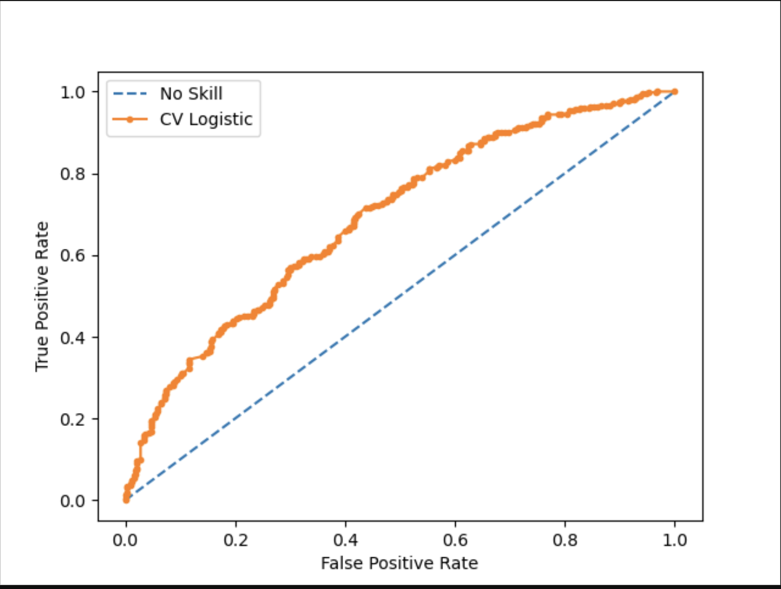
The increased True Positive Rate of the CV logistic regression at given false positive rates indicates that our machine learning made our regression substantially better than guessing

Slide 8
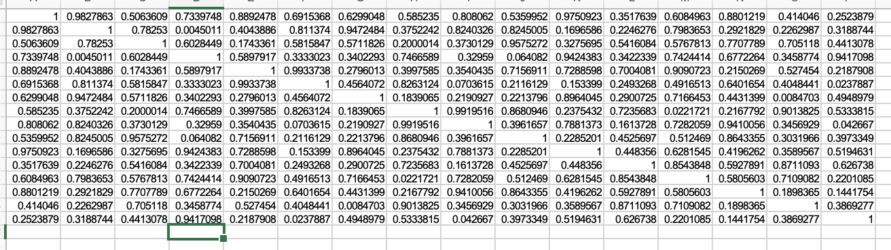
Matrix of Win Probabilities
By predicting a matrix of win probabilities with the sklearn output, we can use random draws values to determine winners in a simulated bracket. By repeating this process through for loops, we can calculate a winning percentage for each team by dividing their total tournament wins over the total iterations of the Monte Carlo simulation

Slide 9
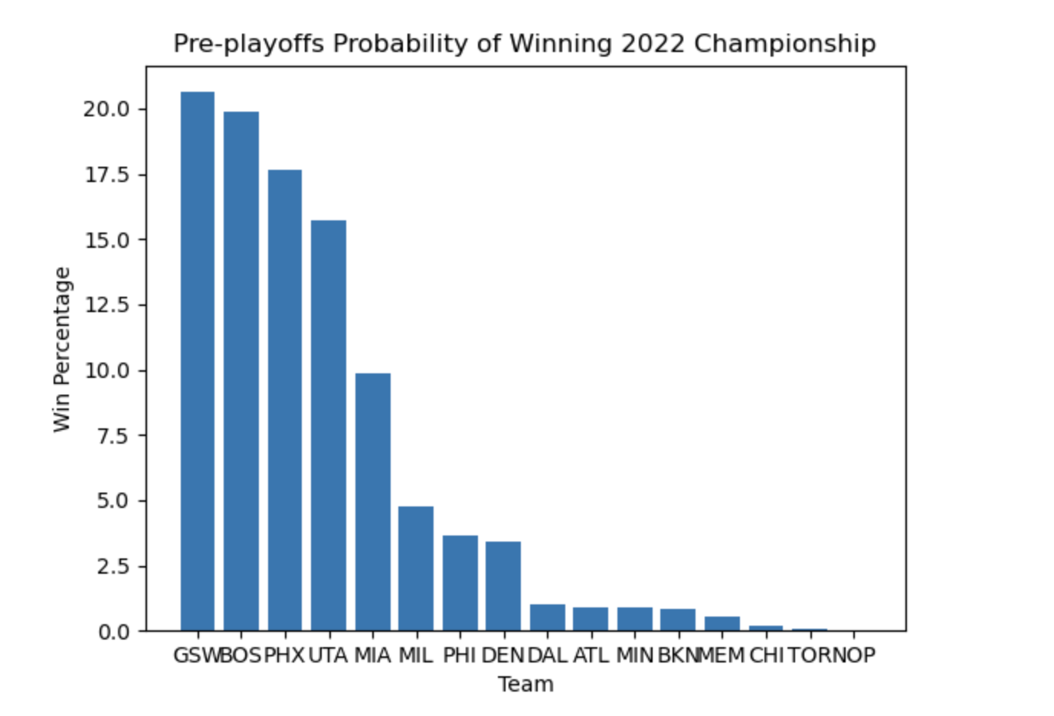
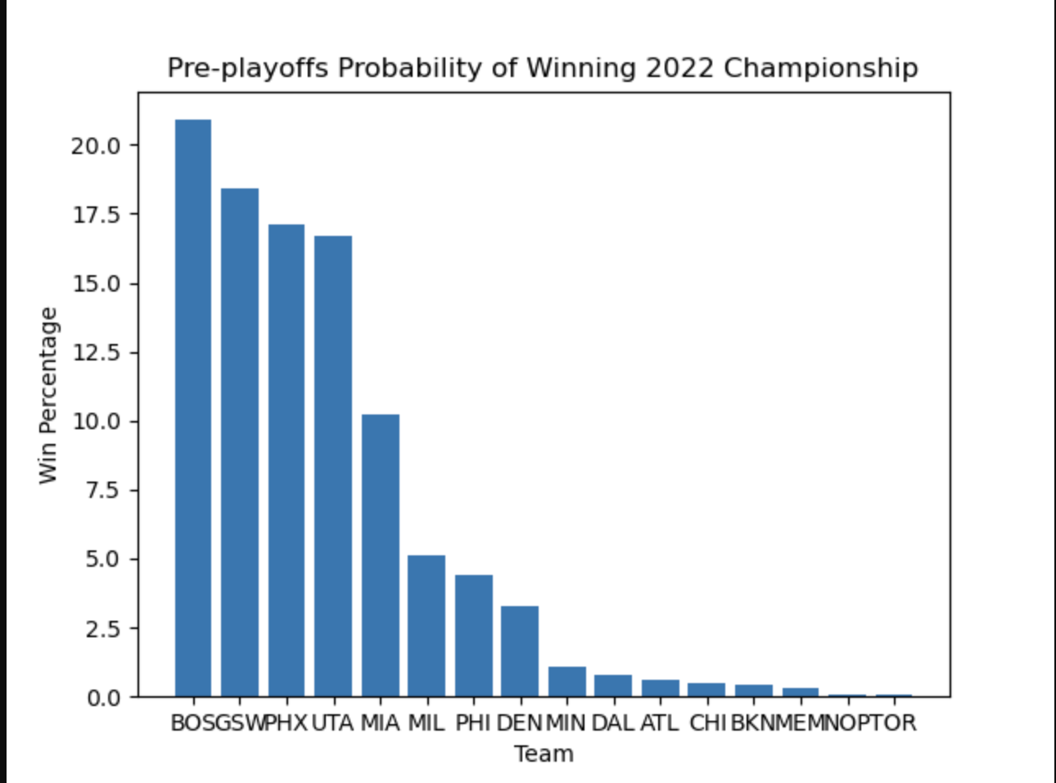
For loops to Probabilities
By recording the iterated steps of our for loop simulation, we can calculate the winning probability for each team
10000 iterations
1000 iterations

Slide 10
Future Exploration
We can utilize in-game statistics for specific players to determine their likely scoring performance, most likely in a range of 95% likely-hood.
We would use feature engineering to decipher the strongest predictors of scoring performance, and use those in a model to predict any given player’s scoring statistics in a mock final.
For example, we may predict that if Golden State Warriors win the final, Steph Curry is likely to score between 27 and 34 points

Slide 11
Data addition Extension
Our analysis also does not account for team strategy/game plan. If our data were to include how each team was most likely to approach each game, and how each of those approaches performs against other approaches, the accuracy of the model may be improved.
Another possibility is to treat coach records against other coaches as another variable in the regression, allowing for strategies to be rolled into coaching style and helping to explain upset games.
The most beneficial addition could be the inclusion of injury data which could help clarify past upset losses, such as the Raptors wins over the Warriors in 2019, and help explain upsets when predicting out.

